Slide 1

New Campus Network Design GROUP 26
Group Members:
Law Rou Rou
Lee Xing Le
Liew Jieh Cheng
Tee Yu Chen
Yen Ming Wey

Slide 2
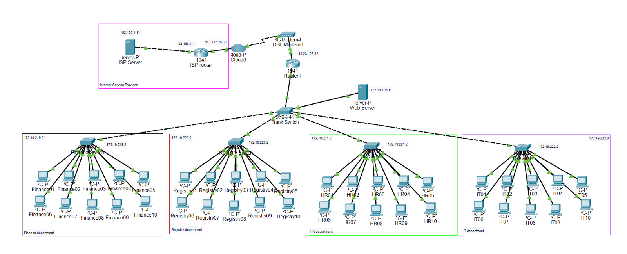

Slide 3

Design Overview
Objectives
Efficient Traffic Management
Enhanced Security
Scalability
Cost-effective
Features implemented
VLAN segmentation
Router-on-stick configuration

Slide 4
VLAN segmentation
Network is logically separated into 5 VLANs (/24)
VLAN ID | Department | Network Address | Subnet Mask
1 | Finance | 172.19.219.0 | 255.255.255.0
2 | Registry | 172.19.220.0 | 255.255.255.0
3 | HR | 172.19.221.0 | 255.255.255.0
4 | IT | 172.19.222.0 | 255.255.255.0
5 | Servers | 172.19.198.0 | 255.255.255.0

Slide 5
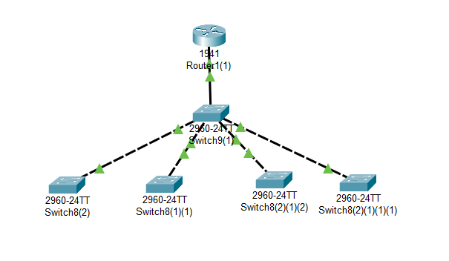
Router-on-stick Configuration
Trunk Port
Trunk Switch
VLAN 1
VLAN 2
VLAN 3
VLAN 4

Slide 6
Benefits of Implemented Features
VLAN segmentation
Enhanced Security
Isolating departments into separate VLANs
Increase Performance
Smaller broadcast domains reduce unnecessary traffic
Flexibility and scalability
Adding new departments or devices becomes easier
Router-on-stick Configuration
Inter-VLAN Routing
Enables communication between VLANs
Cost-Effectiveness
Uses a single router interface for multiple VLANs

Slide 7
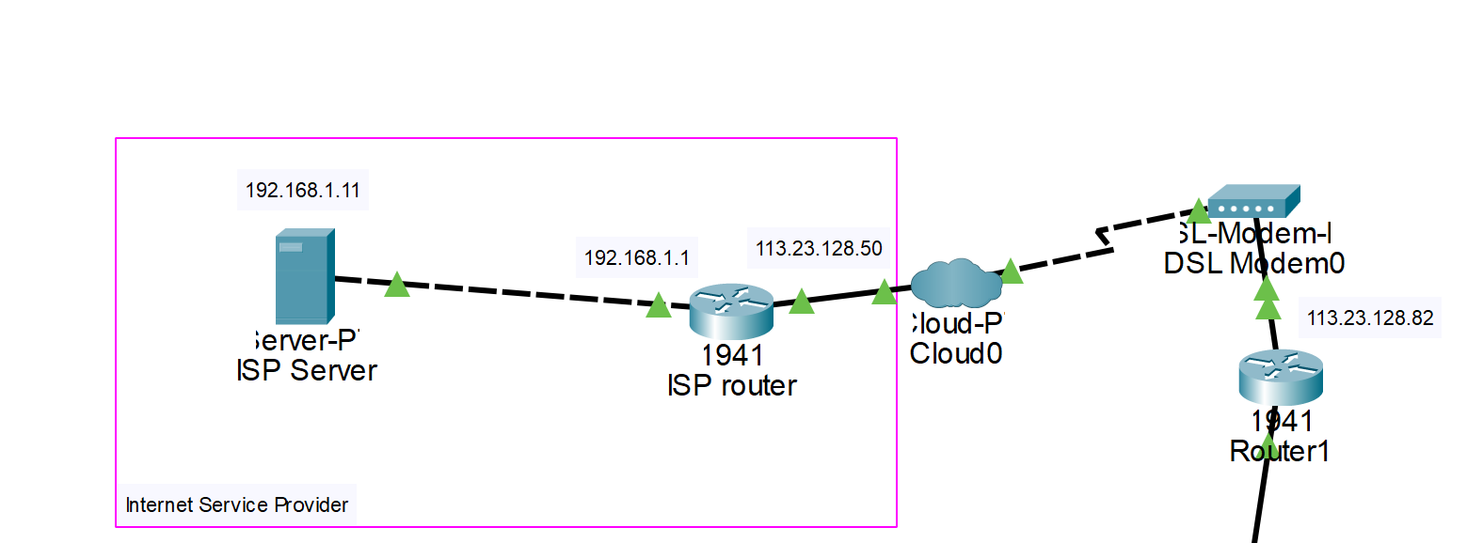
Router
The GigabitEthernet0/0 interface is connected to the LAN,
while GigabitEthernet0/1 connects to the ISP.
GigabitEthernet0/0.1 for the Finance department: 172.19.219.1
GigabitEthernet0/0.2 for the Registry department: 172.19.220.1
GigabitEthernet0/0.3 for the HR department: 172.19.221.1
GigabitEthernet0/0.4 for the IT department: 172.19.222.1
GigabitEthernet0/1
to ISP
GigabitEthernet0/0
To LAN

Slide 8
Purpose
Efficient and Centralized Network Architecture
Precise Traffic Control and Routing
Optimized Network Performance and Bandwidth Utilization
GigabitEthernet0/1
to ISP
GigabitEthernet0/0
To LAN

Slide 9
Purpose-Scalability
Utilizing Sub-Interfaces Instead of Physical Interfaces
Virtual Segmentation for Easy VLAN Expansion
GigabitEthernet0/1
to ISP
GigabitEthernet0/0
To LAN

Slide 10
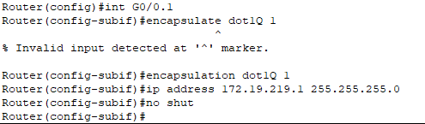
Sub-interface Configuration
Diagram: Configuration for finance department

Slide 11


Routing Configuration
Static Routing between Campus Router and ISP Network
Efficient Data Transfer between Networks

Slide 12
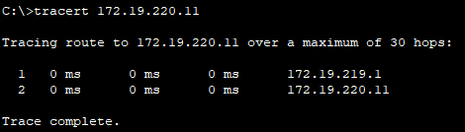
Inter-VLAN Routing
Successful Testing of Inter-VLAN Communication
Departments with Different Default Gateways Connected Seamlessly
Tracert from one department to another

Slide 13

Access switch and VLAN
Each department has own access switch
Connect workstations and other devices within the VLAN

Slide 14

Access Switch
Unique ip address to each department
Finance department – 172.19.219.2 (VLAN 1)
Registry department – 172.19.220.2 (VLAN 2)
HR department – 172.19.221.2 (VLAN 3)
IT department – 172.19.222.2 (VLAN 4)
Allow efficient communication within each department’s network

Slide 15

Access switch configuration
Using “switchport mode access” and “switch port access vlan1” command
Enable switch into access mode
Specifying appropriate VLAN to each department access switch port
Isolate traffic between departments

Slide 16

Benefits of access switch and VLAN setup
Enable secure communication within each department
Ensure the data is contained within its designated VLAN

Slide 17
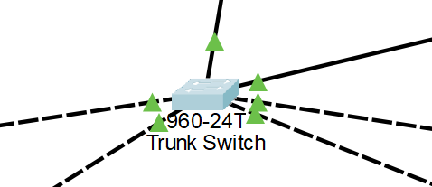
Switch
Trunk Switch
Departments | Interface | IP Address
Finance | F0/1 | 172.19.219.3
Registry | F0/2 | 172.19.220.3
HR | F0/3 | 172.19.221.3
IT | F0/4 | 172.19.222.3
Server | F0/5 | 172.19.198.3

Slide 18
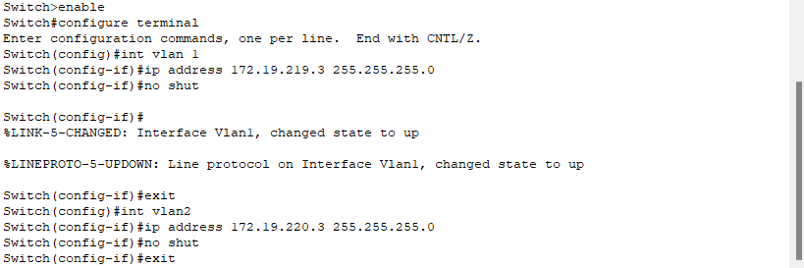

Configuration of Access Ports

Slide 19
Trunk Port
A trunk port can carry traffic for multiple VLANs at the same time
It uses 802.1Q encapsulation to differentiate packets between the VLANs and ensure proper routing and forwarding of data.
This way, the router can handle traffic from different VLANs and enable communication between the VLANs

Slide 20
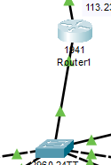
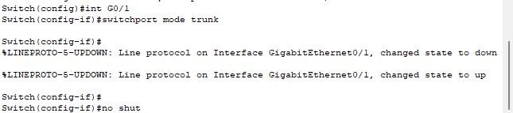
Trunk Port Configuration
To ensure the router can be accessed by all VLANs and allows communication between them, the port connected to the router (G0/1) should be configured in trunk mode.
This can be achieved by using the command "switchport mode trunk" on the switch.

Slide 21
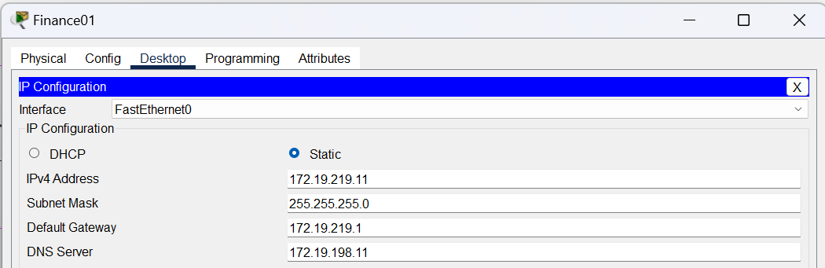
PCs Settings
Departments | Network Address | IP Range | Default Gateway | DNS Server
Finance | 172.19.219.0/24 | 172.19.219.11 – 172.19.219.20 | 172.19.219.1 | 172.19.198.11
Registry | 172.19.220.0/24 | 172.19.220.11 – 172.19.220.20 | 172.19.220.1
HR | 172.19.221.0/24 | 172.19.221.11 – 172.19.221.20 | 172.19.221.1
IT | 172.19.222.0/24 | 172.19.222.11 – 172.19.222.20 | 172.19.222.1

Slide 22
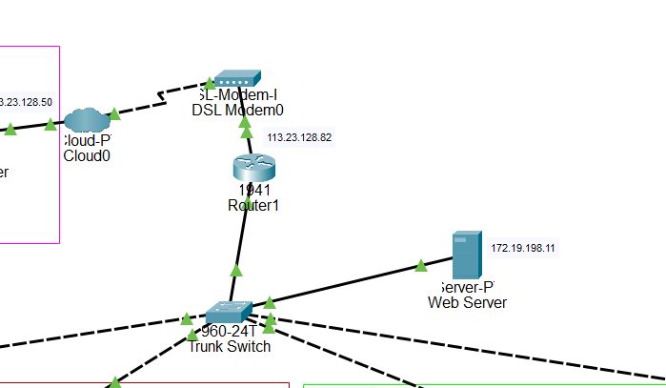
SERVER

Slide 23
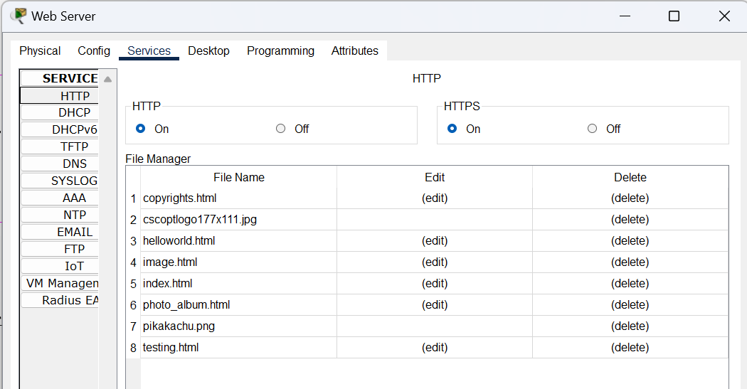
WEB SERVER

Slide 24
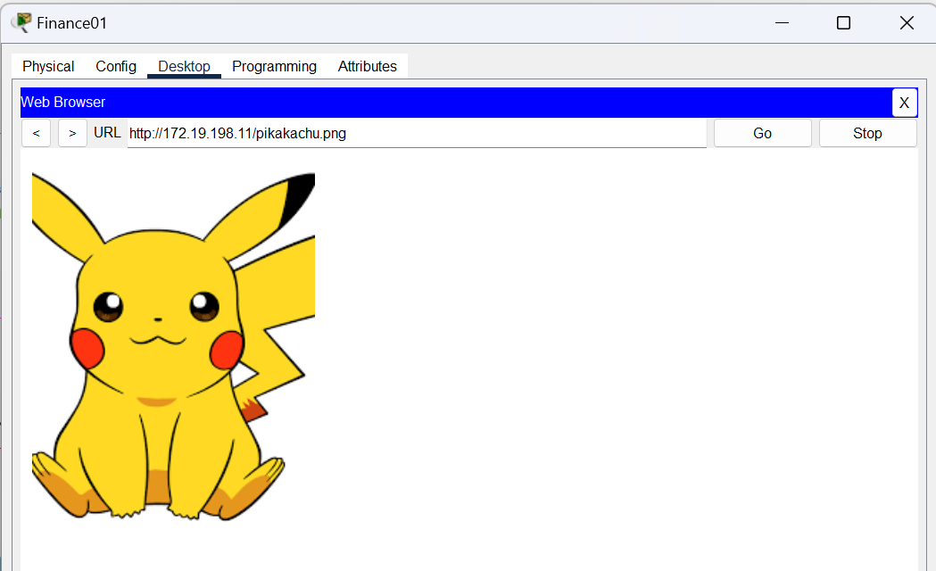
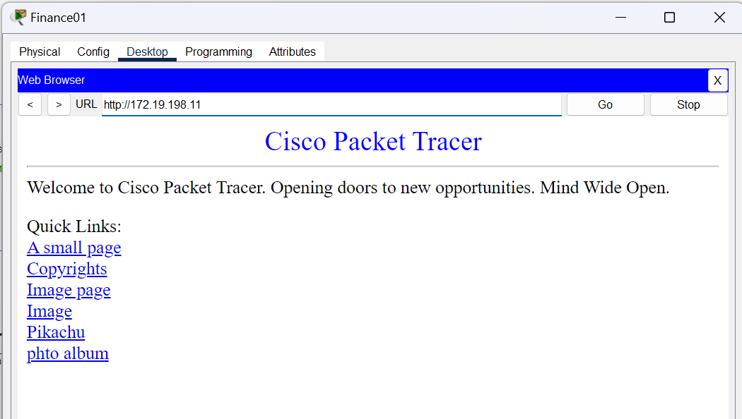


Slide 25
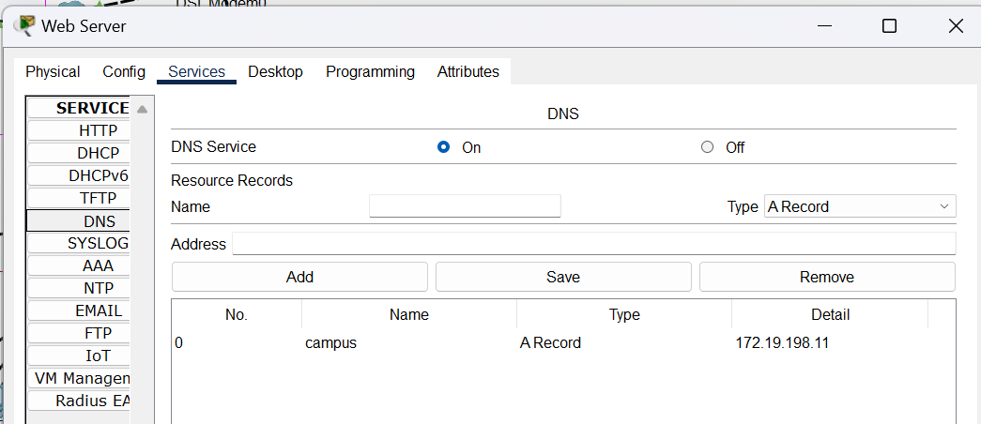
DNS SERVICE

Slide 26
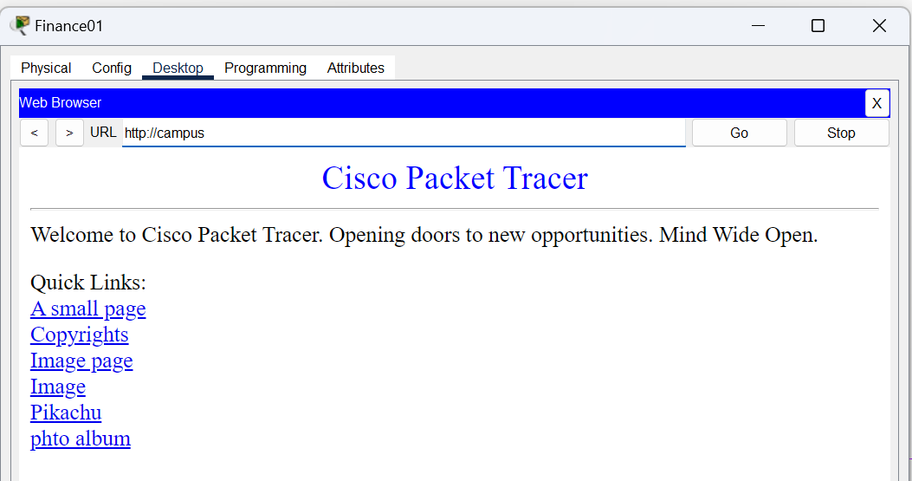

Slide 27
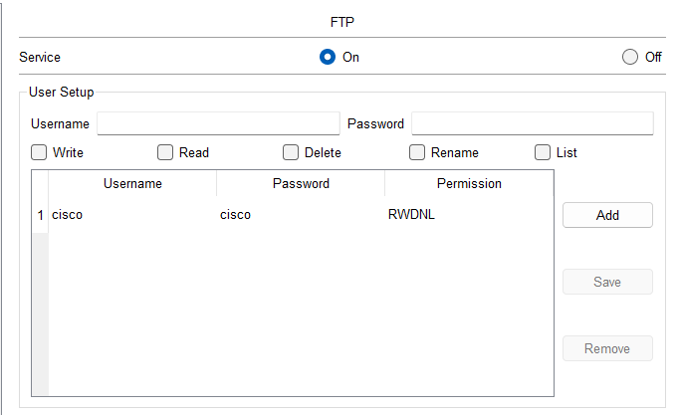
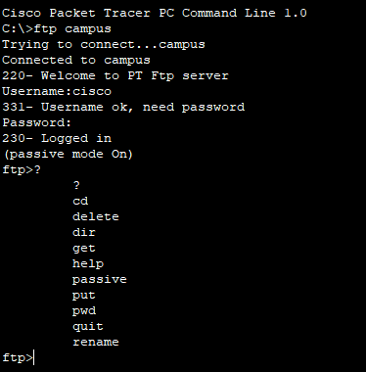
FTP SERVER

Slide 28
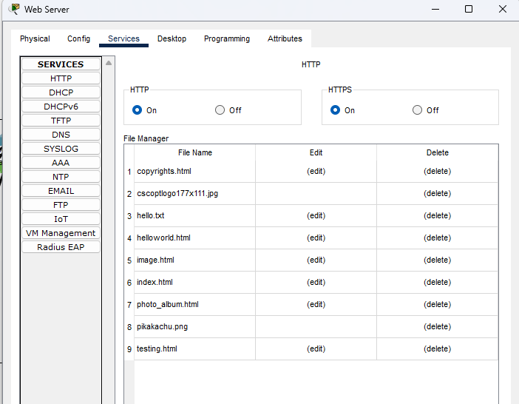
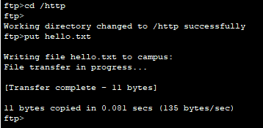
FTP SERVER

Slide 29
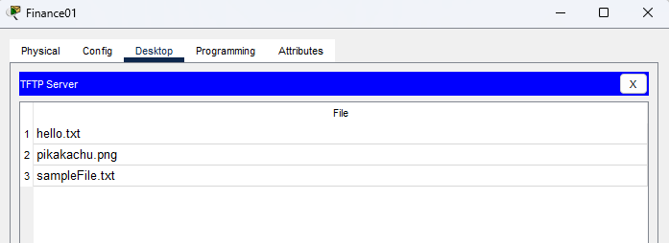
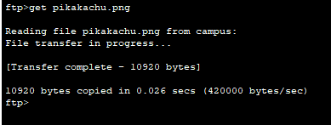

Slide 30
Thank You ☺

